Slide 1
MACHINE LEARNING BASED DETECTION OF APPLICATION LAYER DDoS ATTACK
Arun Balaji B-125157008
Jannesh Evans P-125157025
Vimal K-125157079
Guide
Dr. KANNAN BALASUBRAMANIAN, SOC
‹#›

Slide 2
Layout of this Presentation
Base Paper
Motivation
Objective
Problem Statement
Literature survey
Modules
Dataset
Work plan
Proposed Techniques
Timeline For Completion
References
‹#›

Slide 3
Base paper
Dyari mohammed sharif,Hakem Beitollahi and mahdi fazeli, “Detection of Application-Layer DDoS Attacks Produced by Various Freely Accessible Toolkits Using Machine Learning”
Date of publication : 25 May 2023
Journal:IEEE Access
‹#›

Slide 4
Motivation
Distributed Denial of Service (DDoS) attacks are a growing threat to online services ,as they can overwhelm servers or networks with a flood of traffic, rendering the targeted service inaccessible to legitimate users .
Application-layer DDoS attacks target the application layer of the victim system, aiming to exhaust its resources or cause the application to fail.
In recent years there was a significant increase in application-layer attacks, specifically HTTP-layer DDoS attacks which rose by 164% Year over year
The main aim here is to perform efficient prediction on the DDoS attack and the tools used to launch it.
‹#›

Slide 5
Objective
An approach to predict the application layer DDoS attacks using Machine Learning .
To identify the tools used to launch the attack.
To implement feature Selection techniques to enhance the speed and efficiency of the system.
Our main aim is to fill the gap by investigating the impact of easy availability of DDoS attack tools on the frequency and severity of attacks.
‹#›

Slide 6
Problem Statement
To construct a ML model to detect DDoS attacks by identifying and distinguishing between traffic produced by freely accessible tools and legitimate traffic.
‹#›

Slide 7
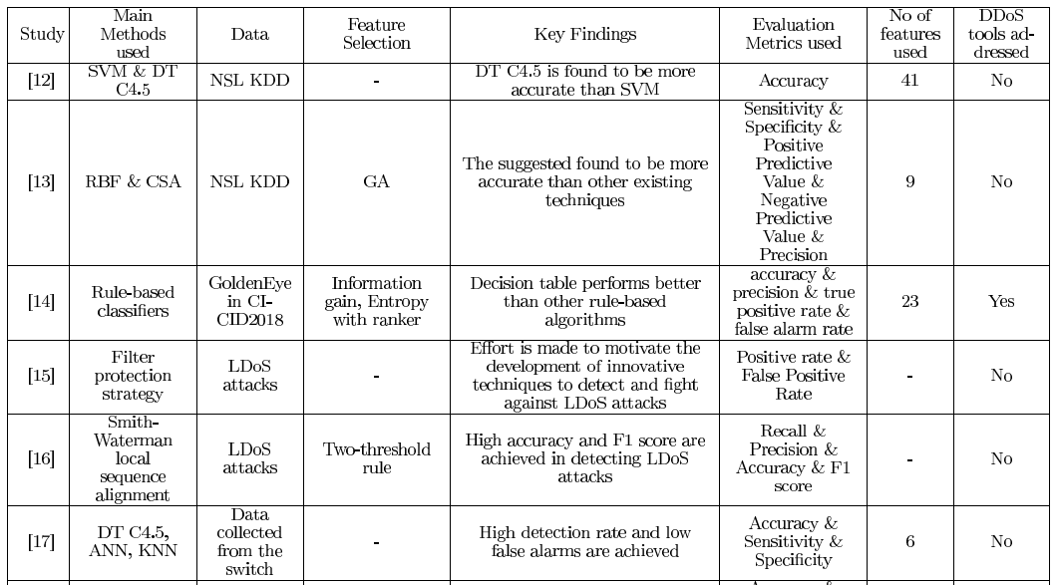
Literature survey
‹#›

Slide 8
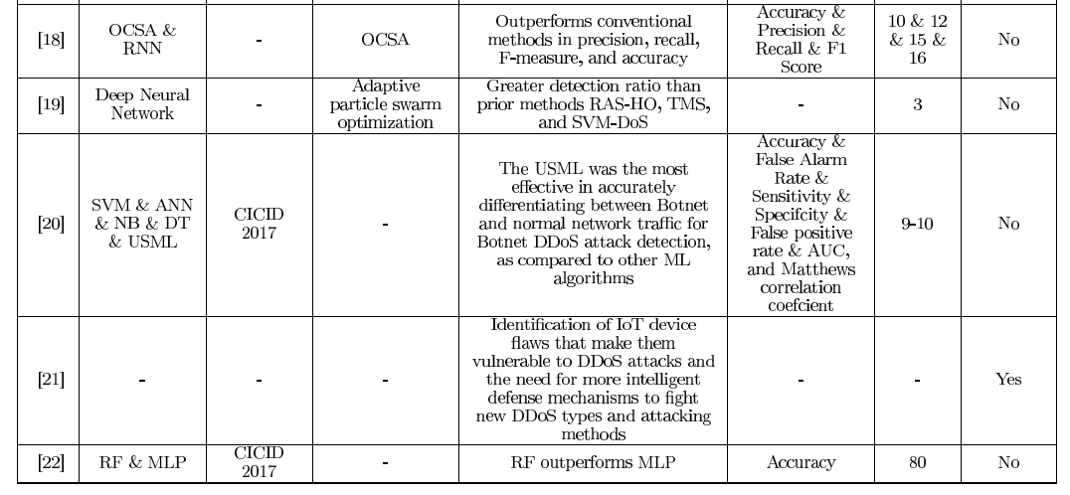
Literature survey
‹#›

Slide 9
Modules
Module 1: Feature Selection
- Decision Trees
Module 2: Data Scaling
- Min-Max Standard Scaler
Module 3: CLASSIFIER
- Multilayer Perceptron (MLP)
- Random Search (RS)
‹#›

Slide 10
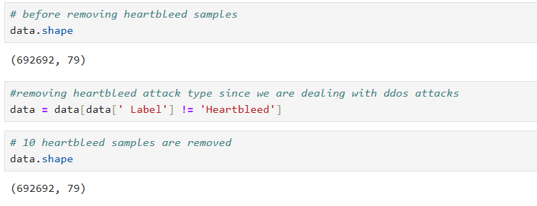
A. DATASET
The dataset originally has 692702 samples.
HeartBleed attack samples are eliminated from the dataset, resulting in a final dataset of 692692 samples with having 78 features

Slide 11
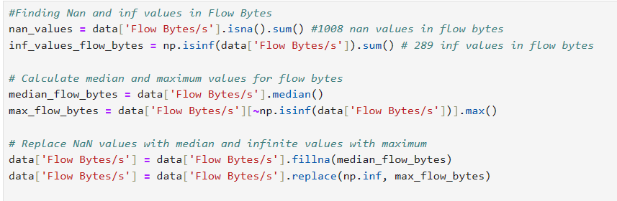
B. DATA PREPARATION
In this dataset, our data, with the exception of a few feature columns, was clean and ready to use
There are a total of 1008 nan values present inside the Flow Bytes/s feature.
In addition, there are 289 infinite values present inside the Flow Bytes/s features.
The nan and infinite values are substituted with the median and the maximum values of the feature column.

Slide 12
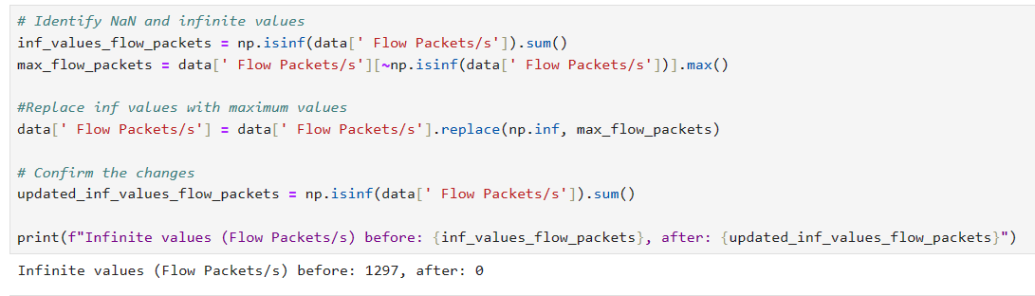
In addition, there are 1297 infinite values present inside the Flow Packets/s features.

Slide 13
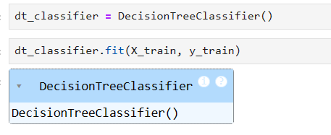
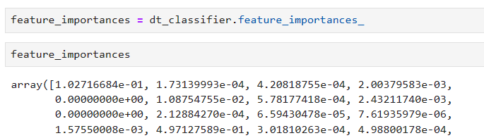
C. FEATURE SELECTION
In our work, we use DT for the purpose of feature selection.
We populate all the data in the dataset to the DT then we consider the importance of features.

Slide 14
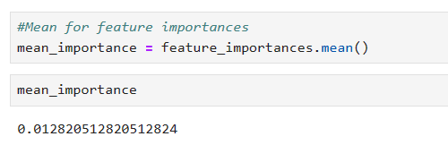
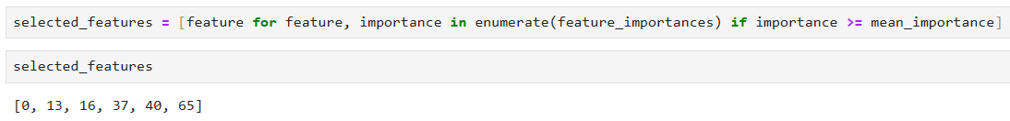
we take the mean of feature importance of all features and use it as a threshold
Any feature with feature importance below the threshold is discarded

Slide 15

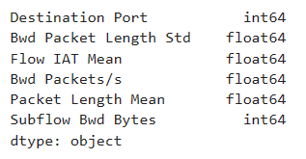
In the end of process, we are left with six features.
It is worth to note that we hold all prime essential features in order to detect diverse and various DDoS attack toolkits.

Slide 16
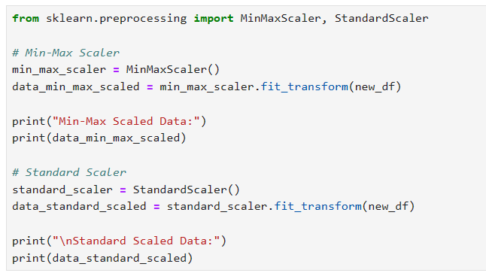
D. DATA SCALING
This work uses the Min-Max Standard Scaler to transform the data into a number between the minimum and maximum values.

Slide 17
E. CLASSIFIER
Choosing the ideal number of neurons and layers in a MLP is an important step in building a neural network.
we use MLP to classify 4 DDoS attacks and benign traffic with 6 features only
The procedure begins with no hidden layers, and considers the accuracy, precision, recall, and F1 score as performance metrics.
The number of hidden layers is subsequently increased incrementally, with the corresponding number of neurons determined through Gridsearch.

Slide 18
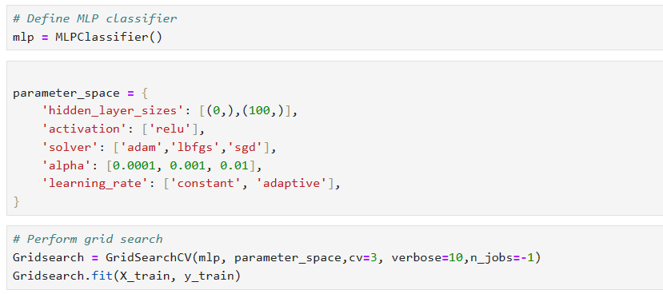

Slide 19
EXPERIMENTS AND RESULTS
After feature selection, the 6 selected features are populated to a MLP of three layers.
The first hidden layer, second hidden layer and third hidden layer consists of 100,200 and 250 neurons, respectively
Based on the evaluation, our model obtains a level of accuracy of 98%, precision of 94%, a level of F1 score of 93%, and recall of 93% with adam optimizer.
There are a variety of optimizers to choose when developing ML methods. SGD, LBFGS, and Adam are three famous optimizers that are frequently used for MLPs.

Slide 20
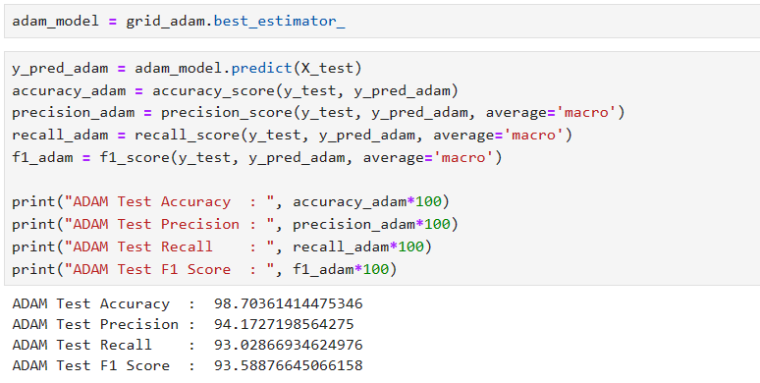
After precise experimentation, we have found that Adam optimizer/solver showed the best accuracy .

Slide 21
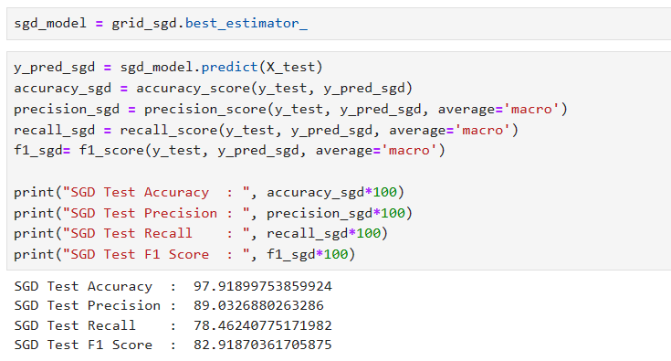

Slide 22
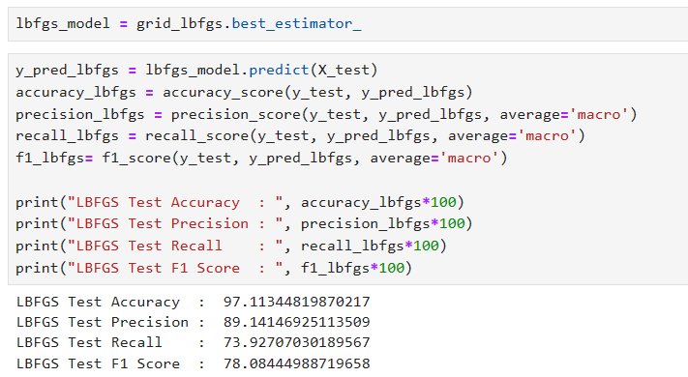

Slide 23
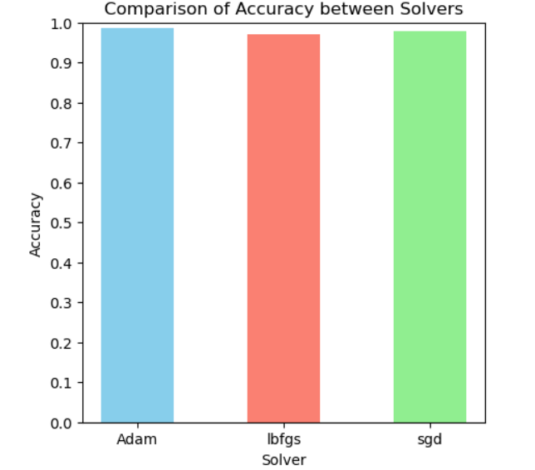

Slide 24
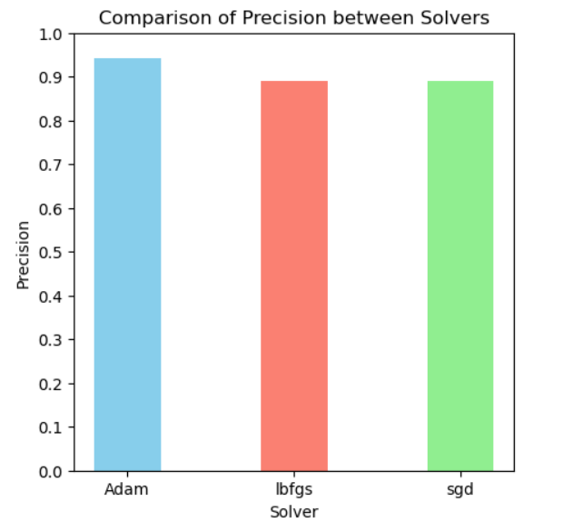

Slide 25
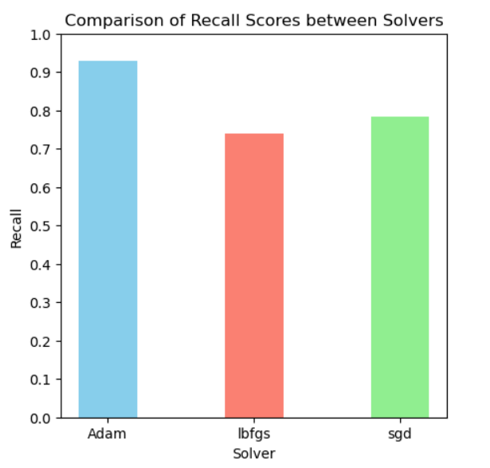

Slide 26
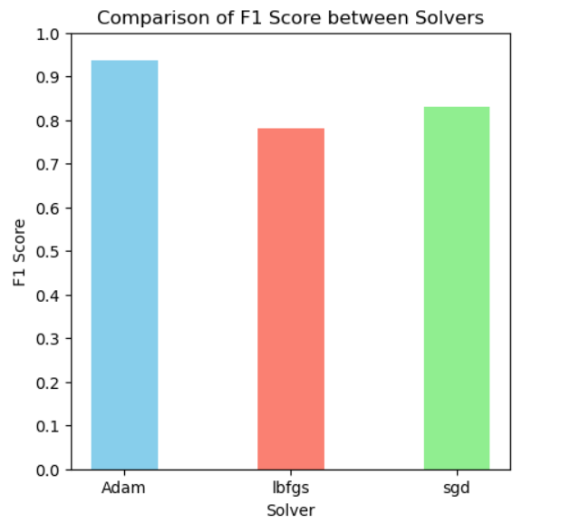

Slide 27
Data Set
The CICIDS2017 dataset is used in this work where the abstract behavior of 25 users are profiled based on the HTTP, HTTPS, FTP, and SSH protocols, as well as email.
The dataset originally has 692702 samples. HeartBleed attack samples are eliminated from the dataset, resulting in a final dataset of 692692 samples with having 78 features.
The dataset was generated in a realistic and diverse environment, which makes it a suitable representation of real-world network traffic.
‹#›

Slide 28
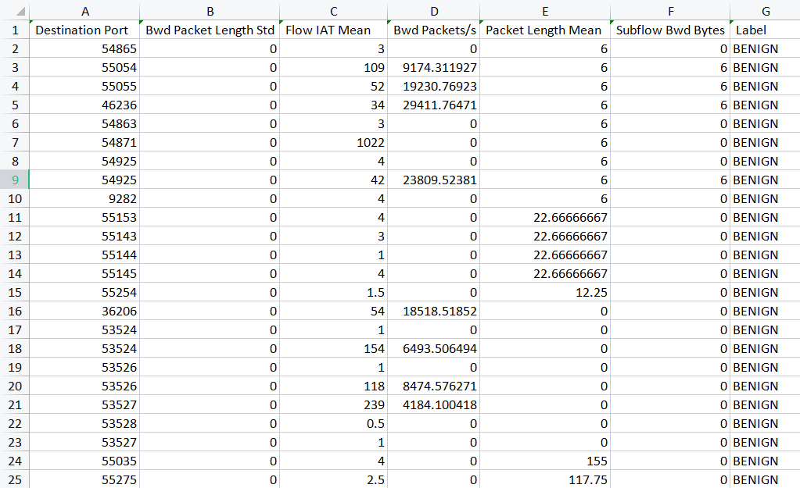
‹#›

Slide 29
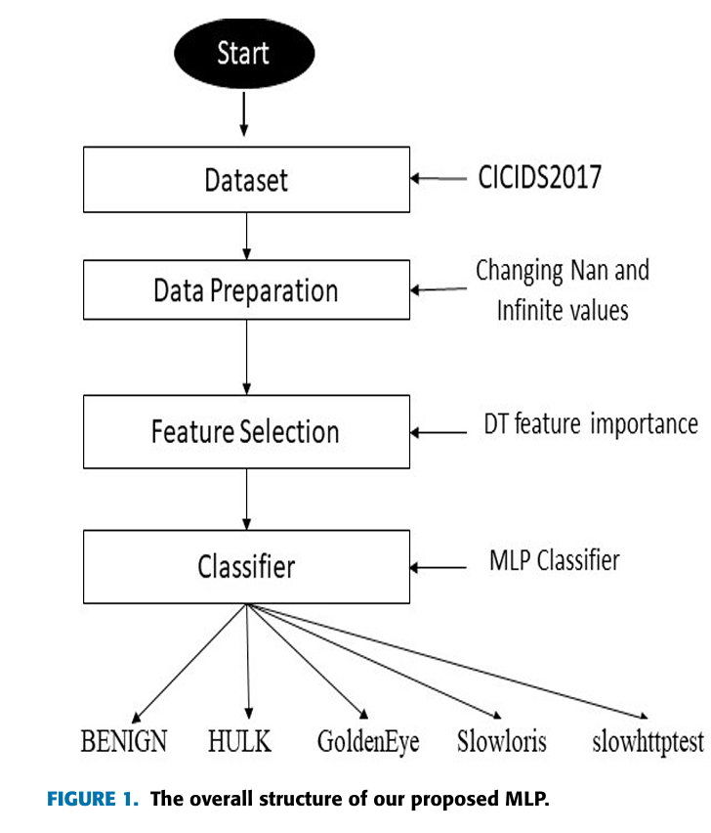
Proposed techniques (Architecture)

Slide 30
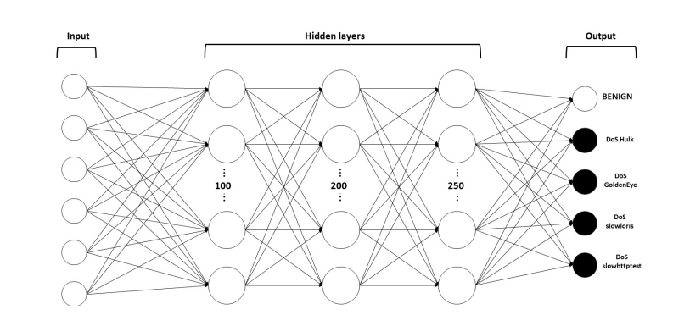
Proposed techniques (Architecture)
The overall structure of our proposed MLP
‹#›

Slide 31
Timeline For Completion
Phase 1:
Completion of data collection, preparation, and cleaning.
Implementation of feature selection and data scaling.
Phase 2:
Implementation of MLP classifier with RandomizedSearchCV for model training.
Comparative analysis of model performance using different optimizers: Adam, SGD, and L-BFGS.

Slide 32
Conclusion
In conclusion, the threat of DDoS attacks is significant due to their potential to disrupt online services and hinder user access.
The accessibility and ease of deployment of DDoS attack tools exacerbate this concern.
Our study employed Decision Trees for feature selection and a Multilayer Perceptron as the classifier, testing various optimizers such as Adam, SGD, and LBFGS.
Our results consistently showed that the Adam optimizer achieved superior accuracy.
‹#›

Slide 33
References
B. B. Gupta, P. Chaudhary, X. Chang, and N. Nedjah, ‘‘Smart defense against distributed denial of service attack in IoT networks using supervised learning classifiers,’’ Comput. Electr. Eng., vol. 98, Mar. 2022
H. Beitollahi and G. Deconinck, ‘‘An overlay protection layer against
denial-of-service attacks”
O. Yoachimik, ‘‘DDoS attack trends for 2022 Q1,’’ Cloudflare, CA, USA,Tech. Rep., Apr. 2022.
J. Mirkovic and P. Reiher, ‘‘A taxonomy of DDoS attack and DDoS defense mechanisms,’’ ACM SIGCOMM Comput. Commun. Rev., vol. 34, no. 2,pp. 39–53, Apr. 2004
‹#›

Slide 34
Thank you
‹#›

